Slide 1
Project of Big Data Analisys
Using secondary Mushroom dataset

Slide 2
Dataset
It includes 61069 hypothetical mushrooms
The caps are based on 173 species (353 mushrooms per species).
Each mushroom is identified as definitely edible or poisonous.
It is characterized by 20 features, divided in numerical and categorical types
The two classes have almost equal distributions
The given information is about the Secondary Mushroom Dataset

Slide 3
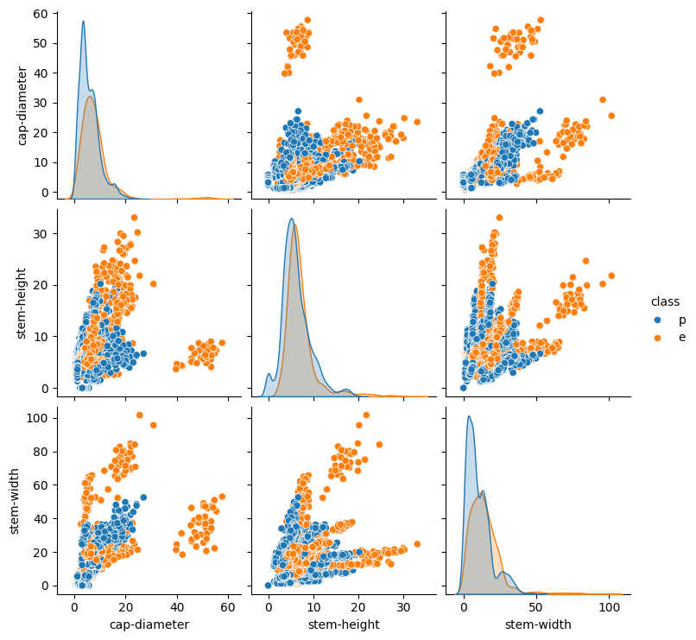
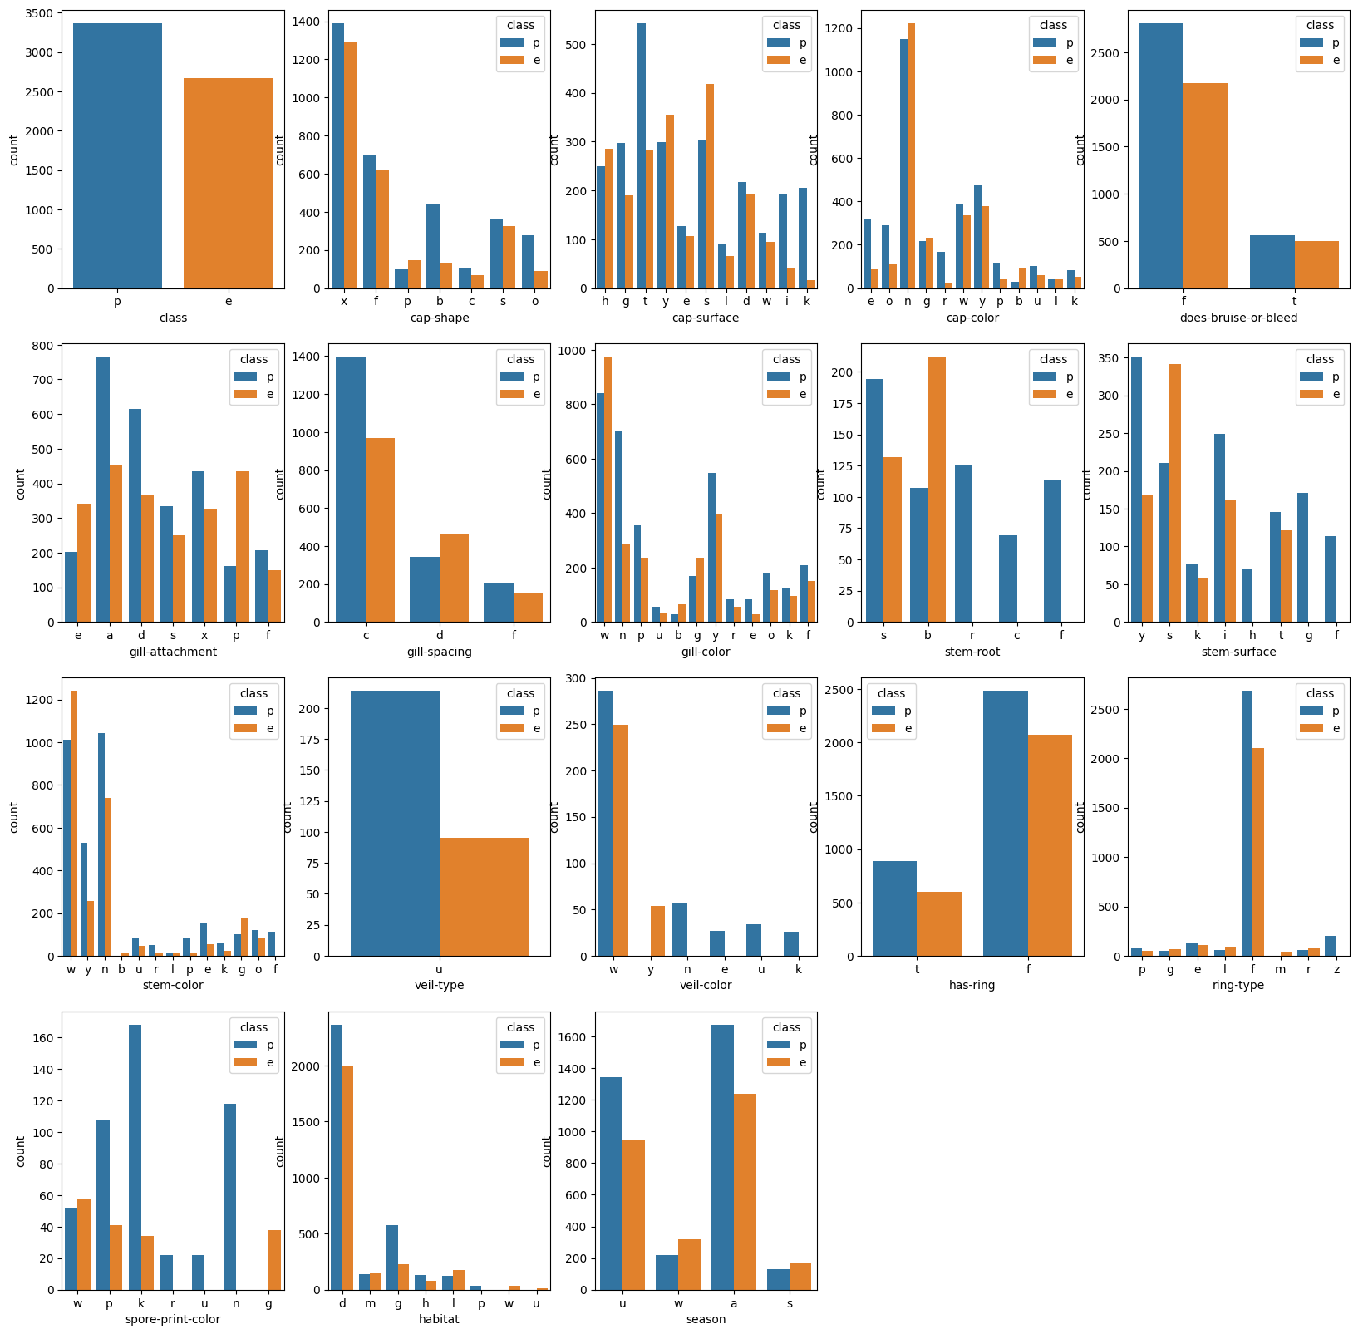
Dataset description

Slide 4
Docker and Spark setup
The Docker image is built upon the official Spark image
We install all the dependencies needed for the task
It runs a Linux enviroment
The Spark session is created through a Jupyter notebook

Slide 5
Data pre-processing
Removal of row duplicates
Omission of columns with the number of Null/NaN greater than 50% of the total number of rows
Replacing of the remaining Null/Nan with the most frequent value in each column
Use of the R-Formula to transform the dataset
All the remaining columns are considered as features
We split the transformed dataset into train and test sets
The objective of the pre-prosessing is to enhance the quality of the data in order to achieve better results

Slide 6
Metrics and Cross-validation
We define specific custom functions for the computations of the metrics (Accuracy, F1, F2, AUC ROC)
They take the labels and the predictions and return the scores
Since it is a binary classification problem, the AUC ROC is the main metric for the evaluation of the performances, and for this reason we also plot the curve on a graph
We use the MLlib cross validator to evaluate the model robustness, combined to a parameter grid for the optimal tuning
The 10-fold cross validator is used to generate 10 training and testing pairs
The metrics are used to evaluate the performances of the models, while the cross-validation is used to find better hyperparameters and to evaluate models robustness

Slide 7
Models
Gaussian Naive Bayes:
Uses the principle of Naive Bayesian probability to make predictions by combining prior knowledge with observed evidences
It is Naive because it assumes indipendences between the features of the dataset
The smoothing handles the problem of zero probability. The best value for this parameter is found to be 1.0
Logistic regression:
Is a supervised learning algorithm that makes use of logistic functions to predict the probability of a binary outcome.
regParam is a regularization parameter that controls the strength of regularization applied to prevent overfitting
elasticNetParam combines L1 and L2 regularization techniques. It balances the two by controlling the mix between them.
Best values: regParam = 0, elasticNetParam = 0.5
We tried multiple models architectures to see which one would have the best performance

Slide 8
Models
We tried multiple models architectures to see which one would have the best performance

Slide 9
Models
We tried multiple models architectures to see which one would have the best performance

Slide 10
Results

Slide 11
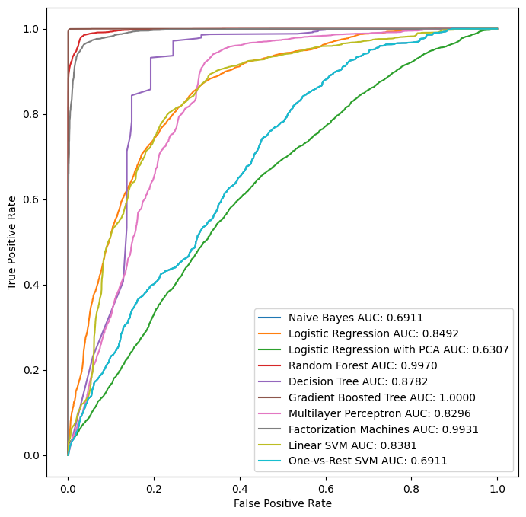
Results
The ROC curves of the models

Slide 12
Project Work

Slide 13
Models

Slide 14
The end

